Slide 2
Advanced Analytics in the Cloud: Azure Machine Learning
Enrico van de Laar

Slide 3

About
Enrico van de Laar
Data & Advanced Analytics Consultant @ Dataheroes
Crazy Data Scientist
Microsoft Data Platform MVP
Author
Speaker
Blogger
Twittter: @evdlaar
Email: enrico@Dataheroes.nl
Blob: https://www.enricovandelaar.com

Slide 4
Advanced Analytics
More and more organizations are looking at implementing Advanced Analytics solutions for various reasons: -> Competitive advantage -> Improve quality -> Optimizing production -> Costs saving -> …
Many of these organizations have exhausted the possibilities of their existing BI platform
But how do you take the next steps in analytics?

Slide 5
Advanced Analytics
There are many different solutions available to implement Advanced Analytics solutions -> R -> Python -> SPSS -> SAS -> MATLAB -> Octave -> Etc…

Slide 6

Advanced Analytics
Why not start with a solution that is easy to use and scale?

Slide 7
Advanced Analytics
Azure Machine Learning is a cloud based analytics solution
Drag-and-drop functionality with no* programming involved
Easy to interpret, configure and build analytical models
Supports many different data sources, including on-premises SQL Server databases
99,95% guaranteed uptime
And…

Slide 8
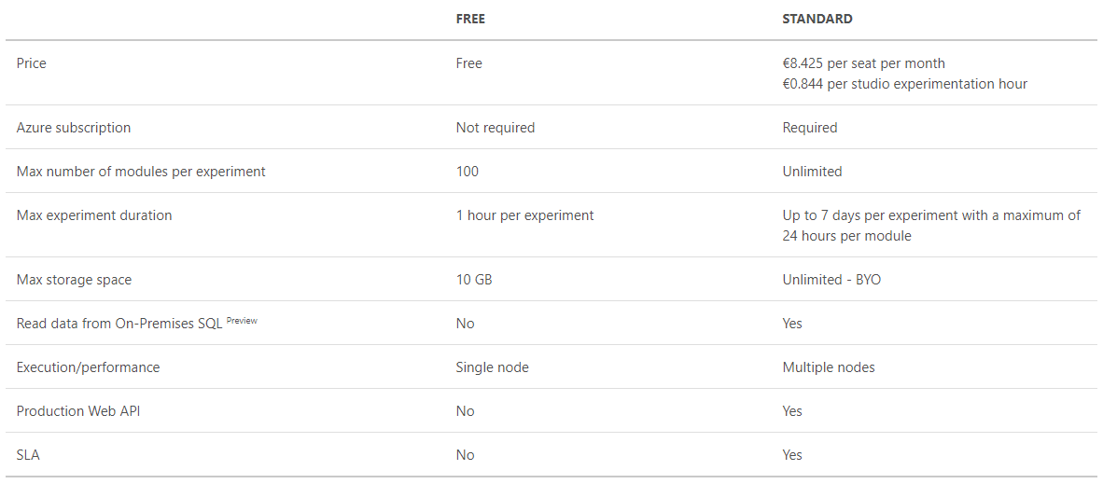
Advanced Analytics

Slide 9
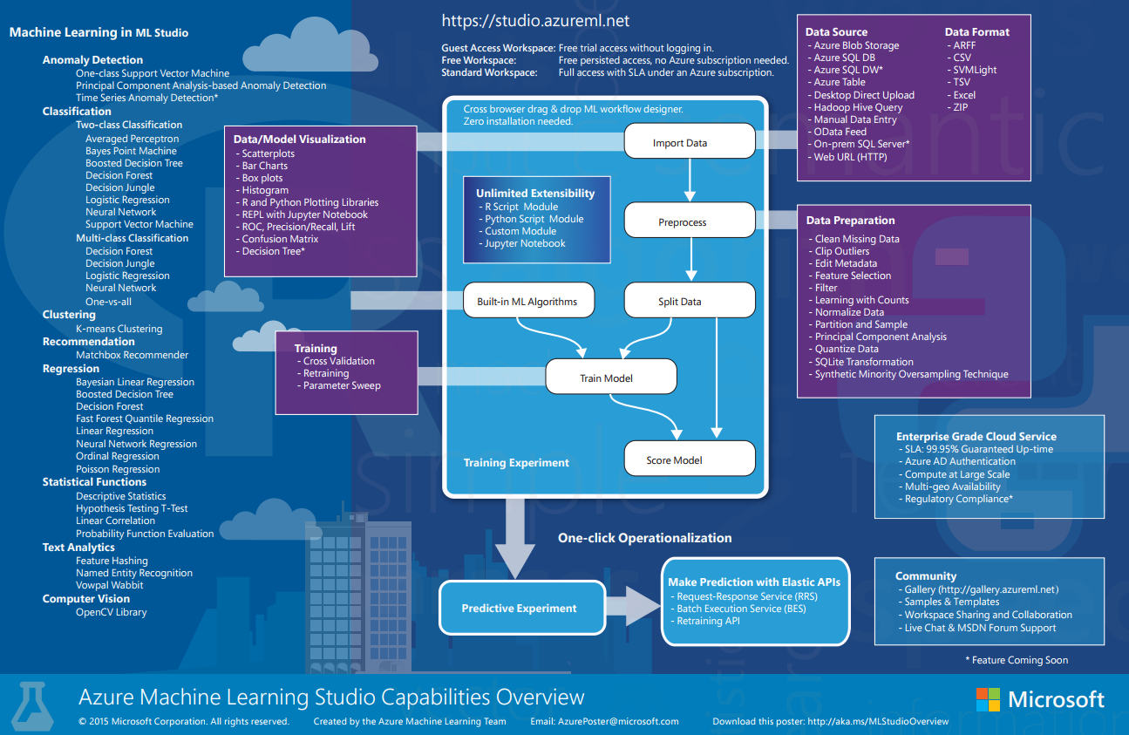
Advanced Analytics

Slide 10
Advanced Analytics
Enough talk, let’s get started with Azure Machine Learning!

Slide 11
Demo
Model training and Scoring using Azure Machine Learning

Slide 12
Questions?

